Slide 1

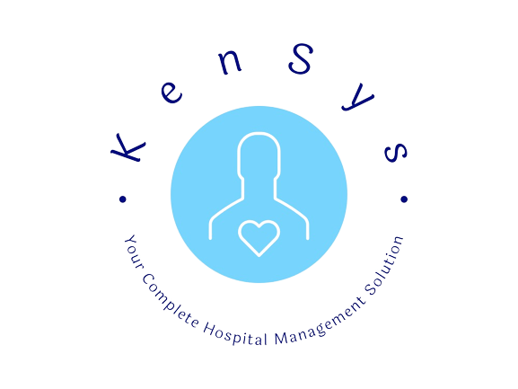
Kensys: Revolutionizing Healthcare with Advanced Chatbot Technology
Introducing Kensys, the hospital management system that connects patients with the best doctors and nurses, tailored to their health needs.
by BitBashers

Slide 2

The Problem with Traditional Hospital Management Systems
Limitations and challenges with traditional hospital management systems often lead to inefficient healthcare experiences. Patients are left feeling frustrated and unattended to.
1
Long Wait Times
2
Lack of Personalization
Patients often wait for long periods of time without receiving the attention they need.
Patients are not matched with healthcare providers who meet their specific needs and preferences.
3
Poor Communication
4
Low Patient Satisfaction
Patients often face confusion and miscommunication with healthcare providers.
Patients often feel unhappy with their healthcare experience due to these limitations.

Slide 3
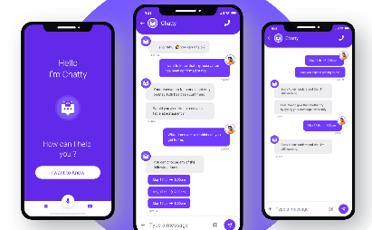


Kensys Hospital Management System: The Solution
Kensys is a revolutionary solution to the problems with traditional hospital management systems. It delivers an efficient and personalized healthcare experience that people deserve.
Chatbot Technology
Matching Patients with the Best Providers
Streamlined Management
Kensys utilizes advanced chatbot technology to provide efficient and personalized healthcare experiences.
Kensys streamlines hospital management for more efficient and effective healthcare solutions.
Kensys matches patients with doctors and nurses who meet their individual health needs and preferences.

Slide 4
The Benefits of Kensys
Kensys delivers a range of benefits to patients and healthcare providers alike. Here are just a few of the advantages:
Personalized Care
Easier Communication
Patients receive personalized care, tailored to their specific needs and preferences
Communication between patients and healthcare providers is streamlined, leading to a more efficient delivery of care
Improved Outcomes
Increased Satisfaction
Patients experience better outcomes due to access to comprehensive healthcare solutions
Patients are more satisfied with their healthcare experiences thanks to Kensys' personalized approach, leading to greater patient loyalty and retention

Slide 5
Features of Kensys
Take a look at some of Kensys' key features with this demo of the app:
1
Connect with Healthcare Providers
According to the doctor's diagnosis Chatbot will analyse which nurse/junior doctor is suitable for the patient.
Two Different Panels
2
Two Separate Panels have been designed for Doctors as well as Nurses, Which makes it more convenient and faster for staff to respond to the patient's need as soon as possible.
3
Better Experience
As the app makes it so seamless for the Doctor's and Nurses to know there patients status so it'll make it a better experience for the Patient.

Slide 6
FUTURE POSSIBILITIES
With features like appointment scheduling and medical records management, our upcoming chat integration in near future will analyze doctor-provided data, matching specialized nurses to patients' diseases. Experience the future of healthcare, seamlessly blending technology and compassion.
An inbuilt alarming feature would be added in case of negligence

Slide 7
THANK YOU

